Slide 1
Adjusting Drawdown Risk and Return Based on Bidding Fraction
Mu-En Wu and Sheng-Hao Lin
National Taipei University of Technology, National Central University

Slide 2
Table of Contents
Introduction
Preliminary
Risk Constrain of Maximum Drawdown
Algorithm and Simulations
Experiments on Real Finacial Underlying (e.g. 0050.tw / 2330.tw / 6505.tw / 2317.tw)

Slide 3
Introduction
Coin Tossing (Head; Num.)
Odds (-1, 2) with Prob. (½, ½)
Horse racing (h1, h2, h3)
Odds ( 2, 3, 6 ) with Prob. (½, ⅓, ⅙)
Kelly Criterion
invented by John Latty Lelly in 1965
optimal bidding fraction for a long run
Ralph Vince extend to multiple outcomes and markets: Levage Space Model.
Applications
Sport betting、Blackjack
Stock trading

Slide 4
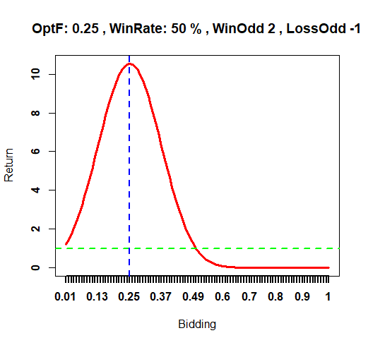
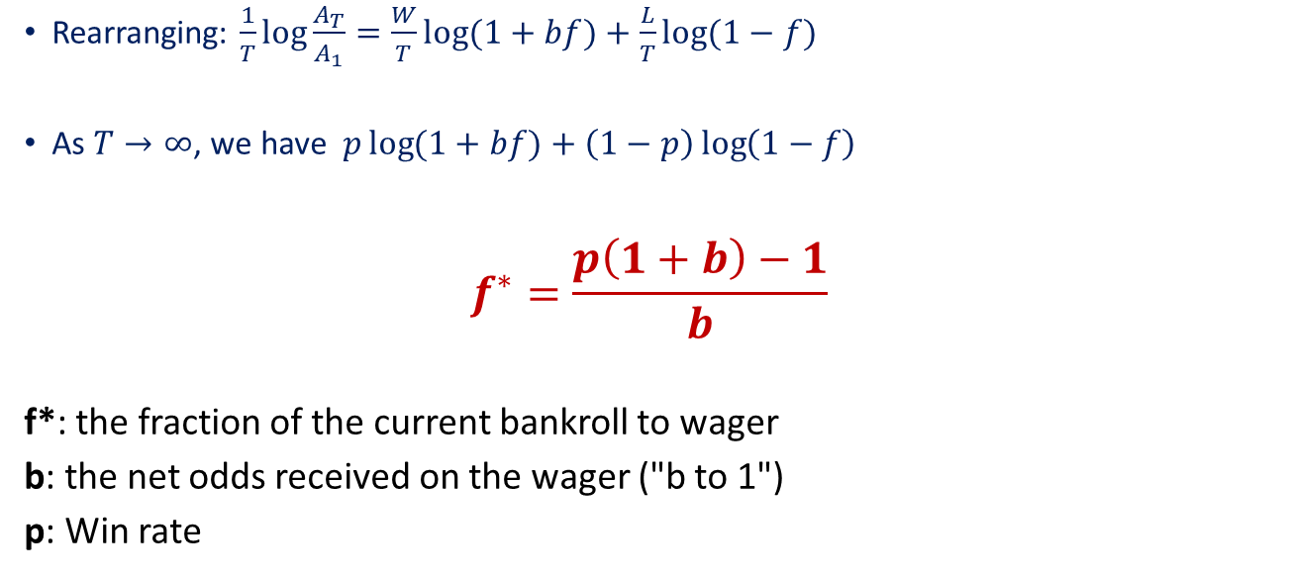
Find f to maximize A_{T}= A₁(1+bf)^{W}(1-f)^{L} ?
Rearranging: $\frac{1}{T}log{\frac{A_{T}}{A_{1}}}=\frac{W}{T}\log{(1+bf)}+\frac{L}{T}\log{(1−f)}$
As $T→∞$, we have$p\log{(1+bf)}+\left(1−p\right)\log\left(1−f\right)$
$$f^{∗}=\frac{p\left(1+b\right)−1}{b}$$
f*: the fraction of the current bankroll to wager
b: the net odds received on the wager ("b to 1")
p: Win rate

Slide 5
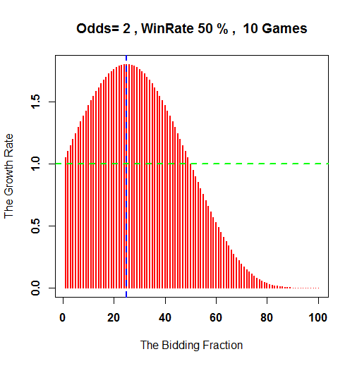
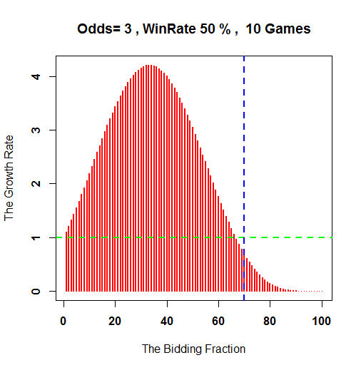
The Key point is Position Sizing!
WinRate 50%, Odds 2
WinRate 50%, Odds 3
Bidding 25%
Bidding 70%
Profit
Loss

Slide 6
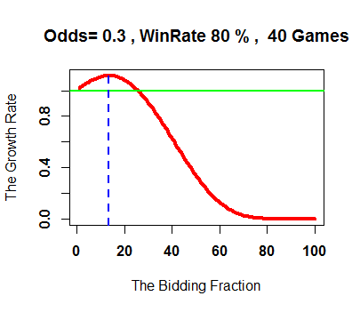
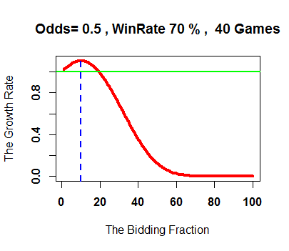
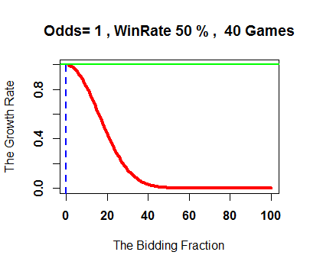
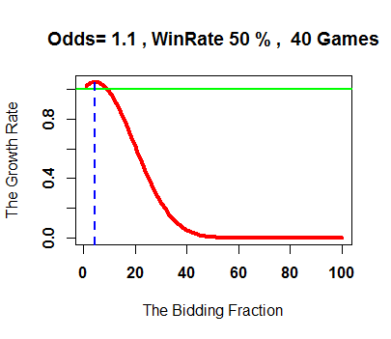
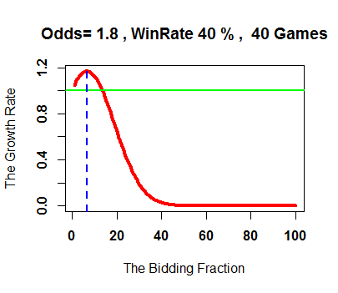
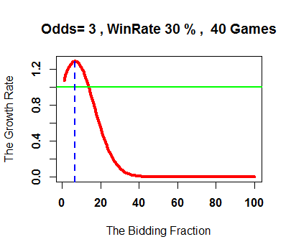

Slide 7
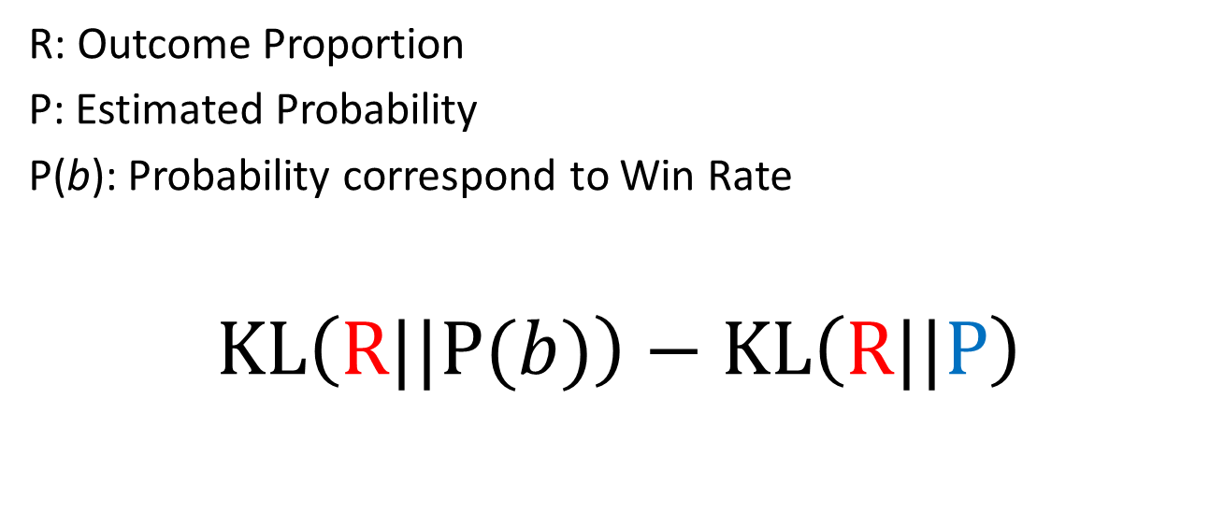
Profit Quantification
R: Outcome Proportion
P: Estimated Probability
P(b): Probability correspond to Win Rate
$$KL\left(R||P(b)\right)−KL\left(R||P\right)$$
Odds
Predict
No one knows
No one knows

Slide 8
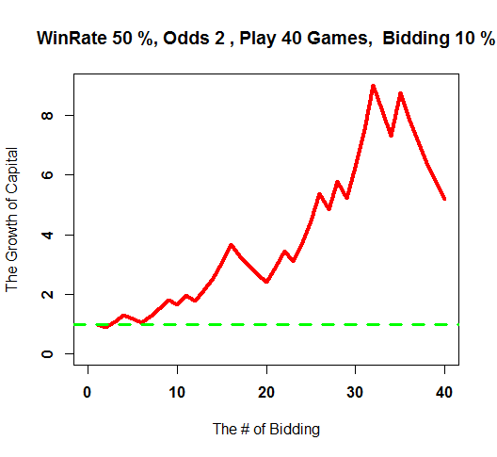
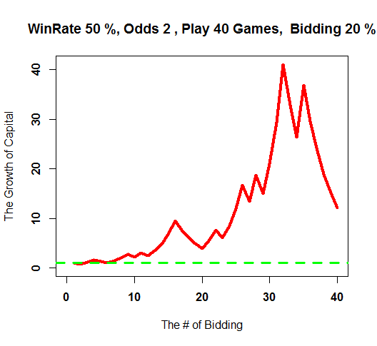
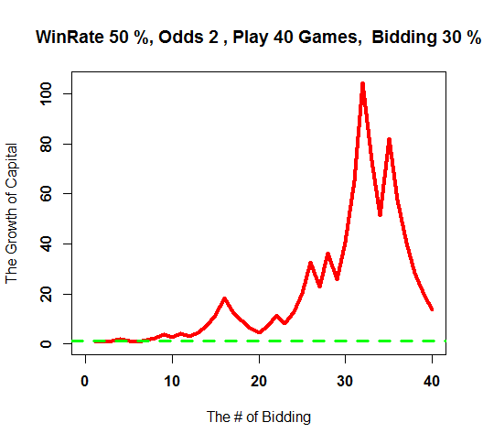
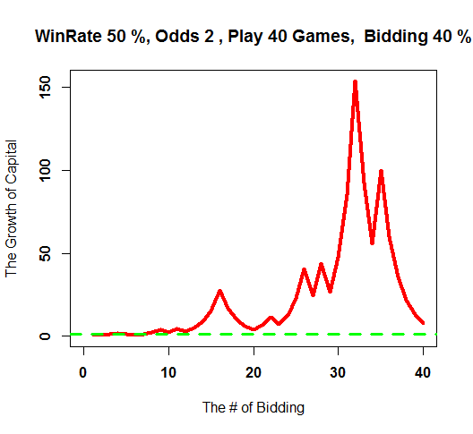
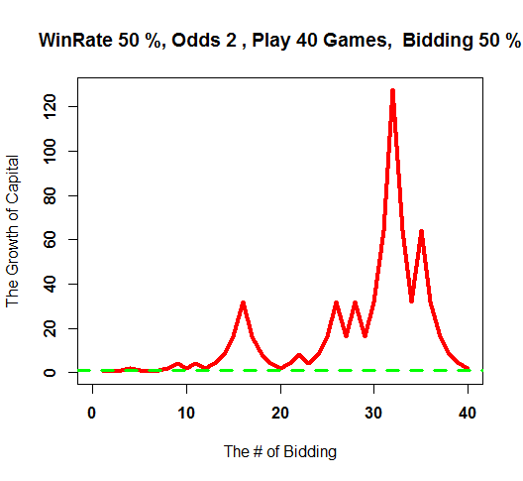
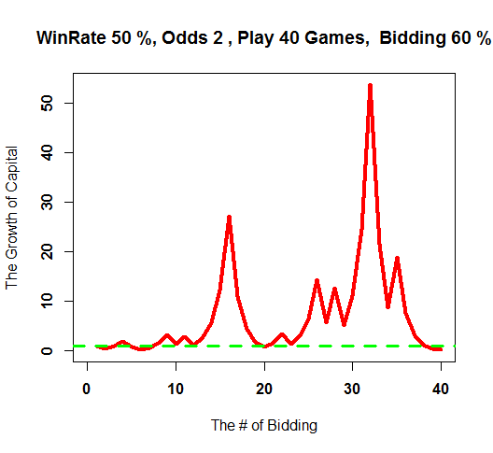

Slide 9

Risk Constraint Kelly Gambling
From the perspective of probability, E Busseti, EK Ryu, S Boyd capture the risk by the following formula.
$Prob. \left(W^{min}<α\right)<β, α,β∈(0,1)$
alpha: is a given target minimum wealth
beta: upper bound of probability
W^{min}: the minimum reltive wealth (initial wealth = 1)
[1] Risk-Constrained Kelly Gambling: E Busseti, EK Ryu, S Boyd - arXiv preprint arXiv:1603.06183, 2016
Notes:
Risk-Constrained Kelly Gambling

Slide 10


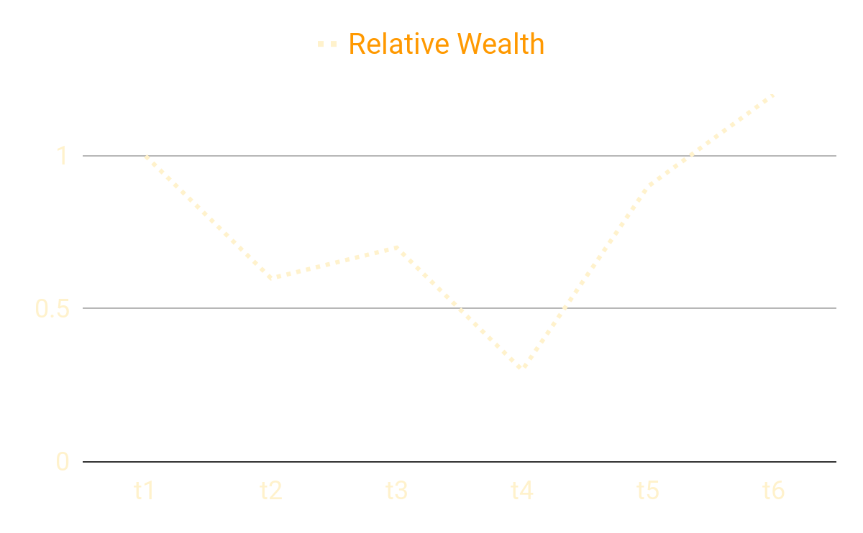
Risk Constraint Kelly Gambling (Cont.)
alpha: is a given target minimum wealth
beta : upper bound of probability
W^{min}: the minimum reltive wealth (initial wealth = 1)

Slide 11

Risk Constraint Kelly Gambling (Cont.)
The $n$ bets have a random nonnegative payoff or return, denoted $r∈ℝ_{+}^{n}$, ${\left(r_{t}\right)}_{n}=1$ ($r$ is i.i.d.)
Find $b∈ℝ^{n}$, $b≥0$ and $1^{T}b=1$
Wealth changes: $w_{t+1}=w_{t}r^{T}b$
The wealth after the bet changes by the (random) factor $r^{T}b$.

Slide 12

Risk Constraint Kelly Gambling (Cont.)
Let $w_{1}=1$, $w_{t}=\left(r_{1}^{T}b\right)$…$\left(r_{t−1}^{T}b\right)$
$\log{w_{t}}=\sum_{τ=1}^{t−1}{\log{r_{τ}^{T}b}}$ is a random walk
Average growth rate of wealth: $𝔼\log\left(r^{T}b\right)$
Goal: Maximize $𝔼\log\left(r^{T}b\right)$ subject to $1^{T}b=1, b≥0,$

Slide 13

Risk Constraint Kelly Gambling (Cont.)
$Prob. \left(W^{min}<α\right)<β, where α,β∈(0,1)$
A bound to the proabability by the parameter $λ=\frac{\log{β}}{α}$
Convex optimization: The the problem is changed to the equations at the right-hand side.
To maximize $𝔼\log\left(r^{T}b\right)$ subject to $1^{T}b=1, b≥0,𝔼{\log\left(r^{T}b\right)}^{−λ}≤1$

Slide 14
Table of Contents
Introduction
Preliminary
Risk Constrain of Maximum Drawdown
Algorithm
Simulations
Experiments on Real Finacial Underlying (e.g. 0050.tw / 2330.tw / 6505.tw / 2317.tw)

Slide 15
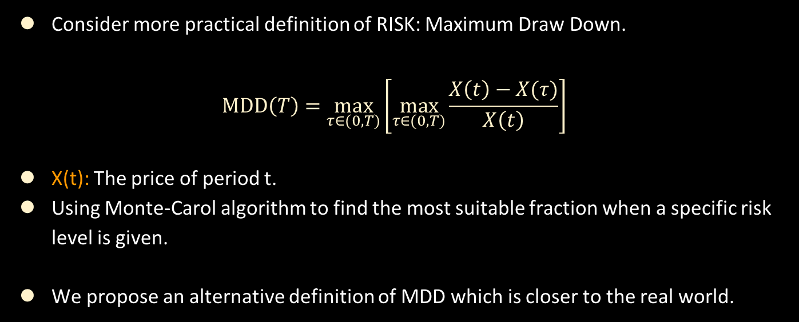
What We Aim to Solve?
Consider more practical definition of RISK: Maximum Draw Down.
$$MDD\left(T\right)=\max_{τ∈(0, T)}\left[\max_{τ∈(0, T)}{\frac{X\left(t\right)−X(τ)}{X\left(t\right)}}\right]$$
X(t): The price of period t.
Using Monte-Carol algorithm to find the most suitable fraction when a specific risk level is given.
We propose an alternative definition of MDD which is closer to the real world.

Slide 16
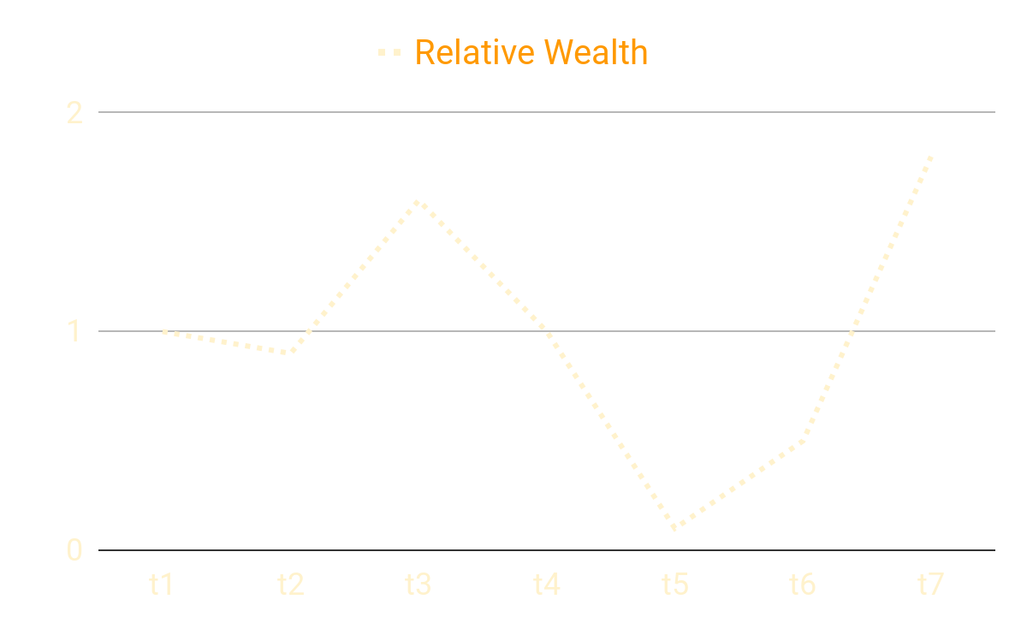
Risk Constrain of Maximum Drawdown (Cont.)
$$MDD\left(T\right)=\max_{τ∈(0, T)}\left[\max_{τ∈(0, T)}{\frac{X\left(t\right)−X(τ)}{X\left(t\right)}}\right]$$
Notes:
先創新高, 在低點, 然後再創新高

Slide 17
Table of Contents
Introduction
Preliminary
Risk Constrain of Maximum Drawdown
Algorithm and Simulations
Experiments on Real Finacial Underlying (e.g. 0050.tw / 2330.tw / 6505.tw / 2317.tw)

Slide 18
Algorithm: A Simple Example for (2,-1)
f=0.1 |  |  |  |  | MDD
1 | 1.2 | 1.08 | 0.972 | 1.1664 | 0.18
1 | 1.2 | 1.44 | 1.296 | 1.5552 | 0.09
1 | 0.9 | 0.81 | 0.729 | 0.6561 | 0.34
f=0.5 |  |  |  |  | MDD
1 | 2 | 1 | 0.5 | 1 | 0.75
1 | 2 | 4 | 2 | 4 | 0.5
1 | 0.5 | 0.25 | 0.125 | 0.0625 | 0.937
return / wealth
Experiment 1 | 2 | -1 | -1 | 2
Experiment 2 | 2 | 2 | -1 | 2
Experiment 3 | -1 | -1 | -1 | -1
Notes:
補再前頁：
用簡單的例子(多圖)說明每次實驗的MDD
[2, -1] [0.5, 0.5]
fraction = 80, 30, 10

Slide 19
Algorithm (Cont.)
# | Algorithm : f* = Algo_f* (n, alpha, beta, odds, win_rate, time_period)
1 | Input: n, alpha, beta, odds, win_rate, time_period Output: f* Initialization: Experiment[] := an array which has length of n, and each element in this array is an array with length of ime_period f_MDD_below_alpha[i] := an dictionary data structure which has keys and their corresponding value results[] := keeps the result of each *f and its corresponding beta
2 | for i = 1 to n :
3 | Based on outcomes defined by odds and its assumption [0.5, 0.5], create an experiment path with length of time_period, and add this path to the array Experiments[].

Slide 20
Algorithm (Cont.)
4 | for f = 0.05 to 1.00 with steps of 0.05 :
5 | for each experiment path in Experiments[] :
6 | Calculate the wealth value of each experiment path with corresponding f.
7 | If MDD(current experiment path) < alpha then:
8 | f_MDD_below_alpha [f] = f_MDD_below_alpha [f] + 1 (keep a record of this f and experiment path)
9 | for each f in f_MDD_below_alpha :
10 | We can calculate out the corresponding beta to this f with the formula : b = f_MDD_below_alpha[f] / n
11 | Keep a record of this b and f into results[]
12 | if b == beta then :
13 | return f

Slide 21
Table of Contents
Introduction
Preliminary
Risk Constrain of Maximum Drawdown
Algorithm and Simulations
Experiments on Real Finacial Underlying (e.g. 0050.tw / 2330.tw / 6505.tw / 2317.tw)

Slide 22
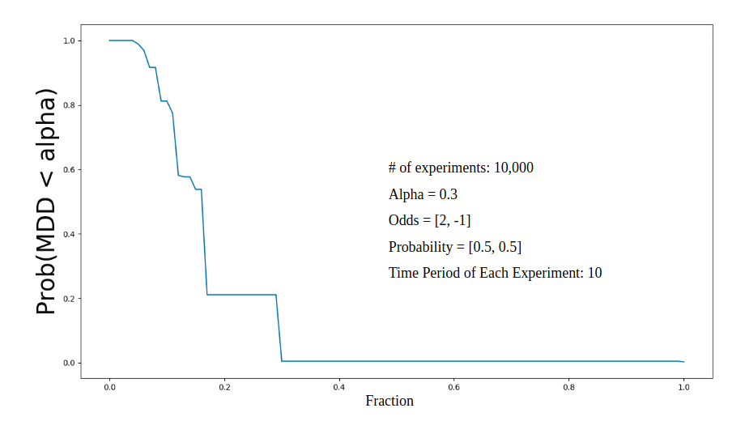
Simulation: alpha = 0.3
0
0.2
0.4
0.6
0.8
1.0
When the alpha is fixed to 0.3, the curve shows us the negative correlationship of beta(Prob(MDD<alpha)) and fraction. In other word, the possibility of suffering drawdown increases as we bet more in each play.
Notes:
y axis: beta 加上文字敘述

Slide 23
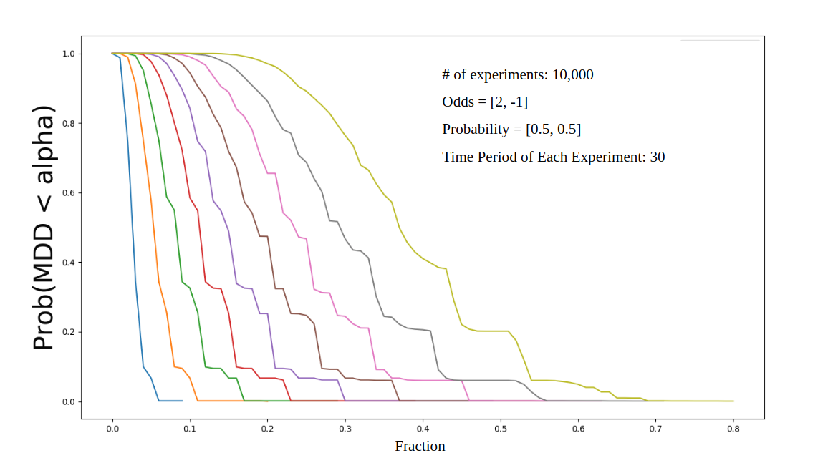
Simulation
alpha = 0.9
alpha = 0.1
0
0.1
0.2
0.3
0.4
0.5
0.6
0.7
0.8 fraction
0.8
As the alpha decreases, the probability of suffering drawdown increases.
When we fixed the alpha to a level, the higher the fraction, the lower the probability which MDD is below alpha.
Notes:
加上文字敘述, alpha legend 不見

Slide 24
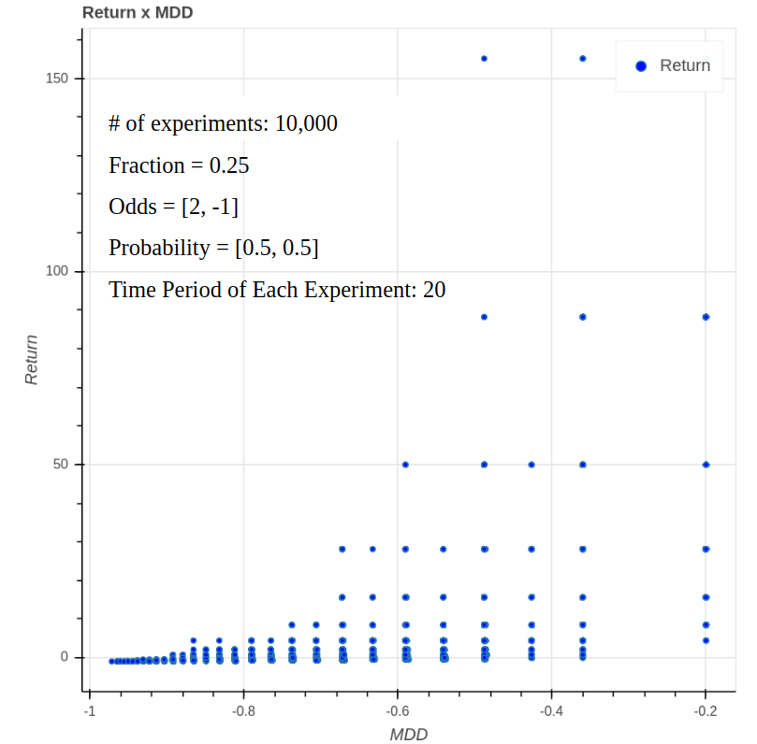
Simulation:
fraction is fixed to 0.25
This graph depicts that a higher MDD will result a lower final return.
Thus, if we can cap the MDD, then implicitly, we can enjoy higher final return.
Notes:
加上文字敘述 玩10次, 把1500拿掉, 畫0~600 MDD 跟RTN負相關, 把座標改成跟17頁一樣

Slide 25
Table of Contents
Introduction
Preliminary
Risk Constrain of Maximum Drawdown
Algorithm and Simulations
Experiments on Real Finacial Underlying (e.g. 0050.tw / 2330.tw / 6505.tw / 2317.tw)

Slide 26
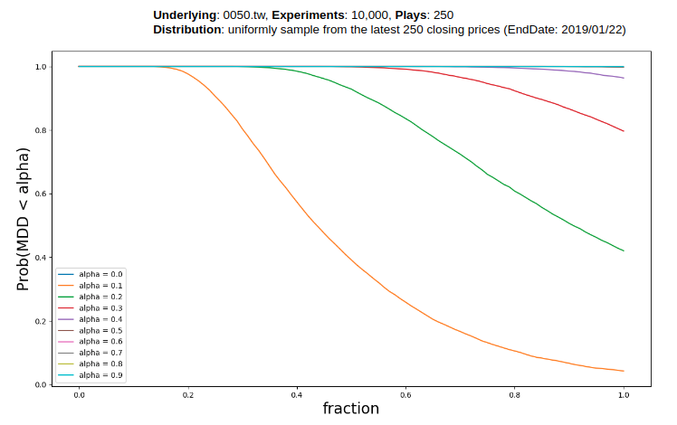
Backtest on 0050.tw
alpha = 0.3
alpha = 0.2
alpha = 0.1
0
0.2
0.4
0.6
0.8
1.0
Comparing to the previous slide, because there is less fluctuation of 0050.tw, all of the curves are closer to the up-right corner. Thus, when we apply the same level of fraction, the beta will be relatively larger than the beta of coin tossing.

Slide 27
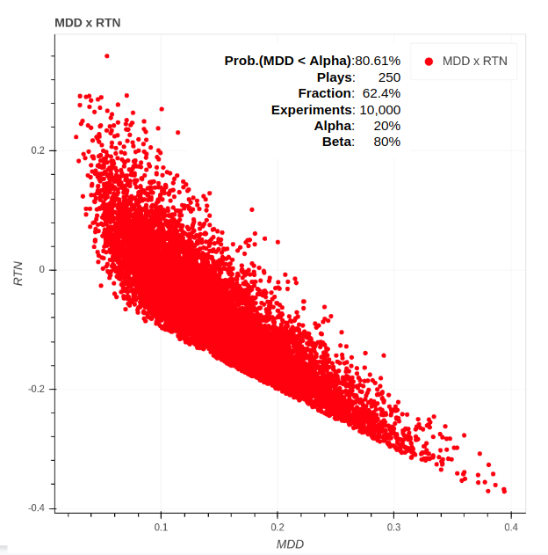
Backtest on 0050.tw
When we fixed the fraction to 62.4%, the simulation tell us that return will decrease as MDD increases.
The result is the same as the last slide.
Notes:
When the alpha is fixed to 0.3, the curve shows us the negative correlationship of beta(Prob(MDD<alpha)) and fraction. In other word, the possibility of suffering drawdown increases as we bet more in each play.

Slide 28
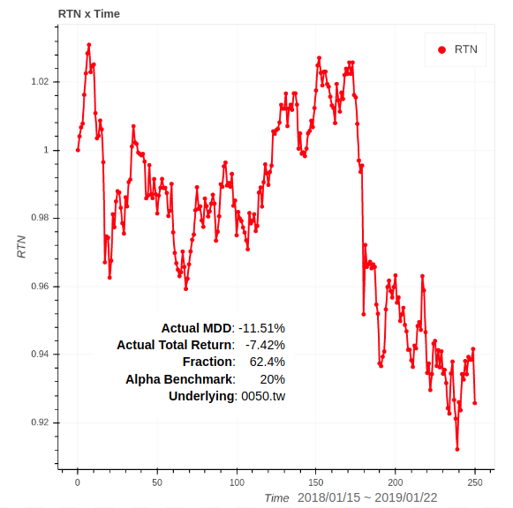
Backtest on 0050.tw
When the alpha is fixed to 0.3, the curve shows us the negative correlationship of beta(Prob(MDD<alpha)) and fraction. In other word, the possibility of suffering drawdown increases as we bet more in each play.
Notes:
加上文字敘述

Slide 29
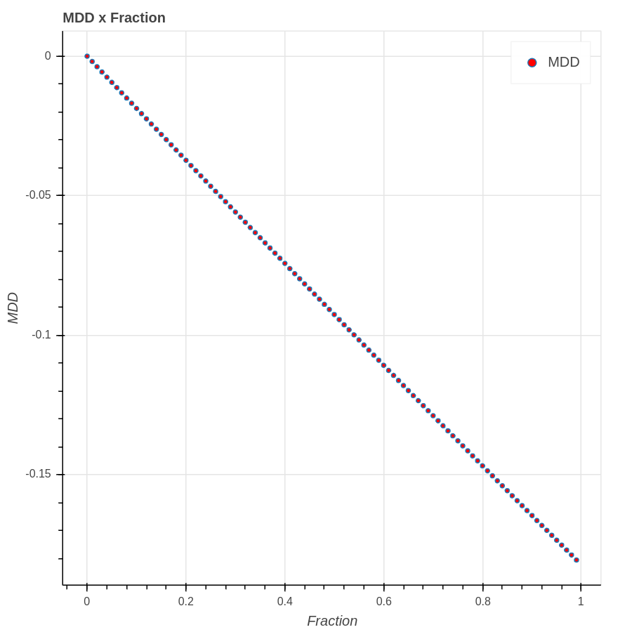
Backtest on 0050.tw:
MDD and Fraction
The MDD happens at the same date no matter what fraction is used.
Thus, the relationship of MDD and fraction looks like a nearly linear relationship.

Slide 30
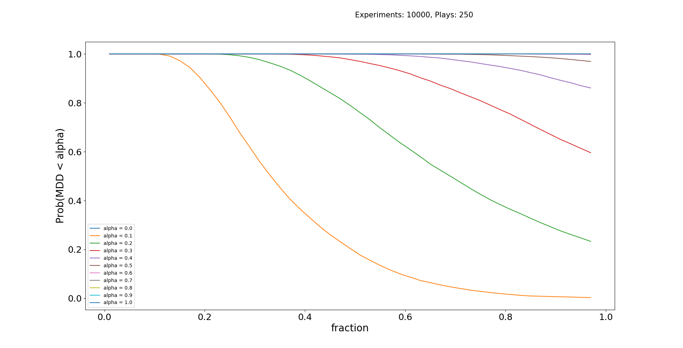
Backtest on 2330.tw (#1 market cap in TW)
Beta > 80% Alpha = 10%
alpha = 0.3
alpha = 0.2
alpha = 0.1

Slide 31
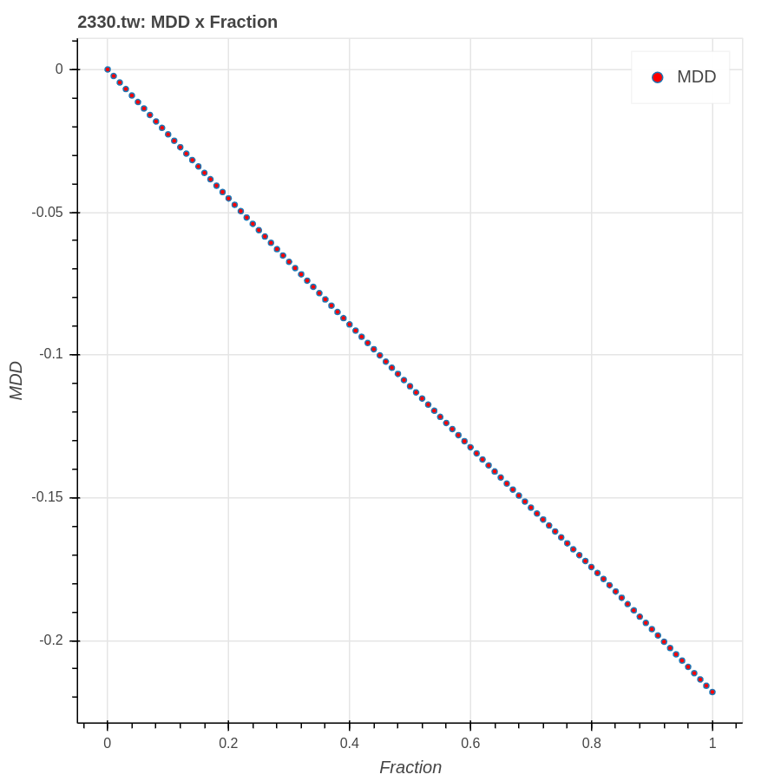
Backtest on 2330.tw:
MDD and Fraction
According to the previous slide, if we want to achieve
Prob(MDD < 10%) = 80%,
our fraction should be about below 22%.
The backtest of real trading data of 2330.tw shows that if we use the fraction below 22%, our MDD can be smaller than 10%.

Slide 32
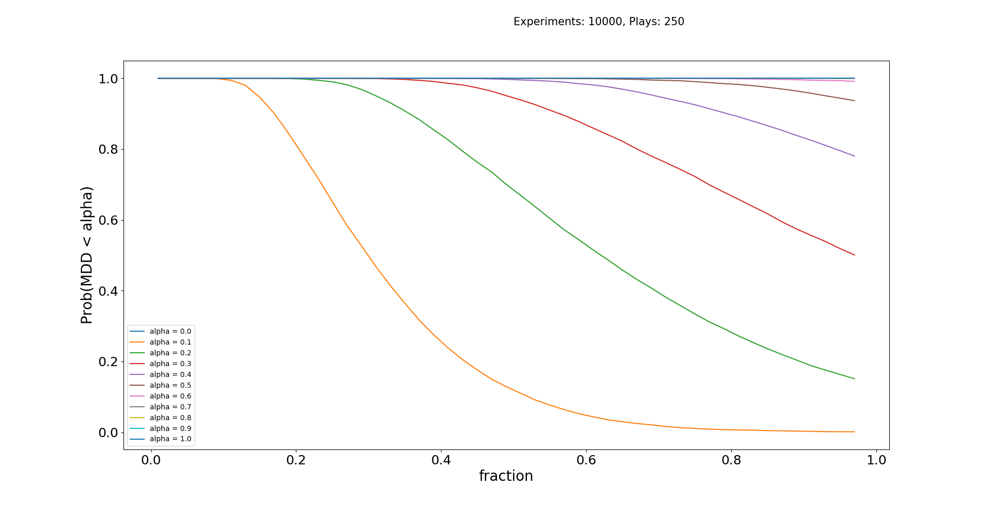
Backtest on 6505.tw (#2 market cap in TW)
Beta > 80% Alpha = 10%

Slide 33
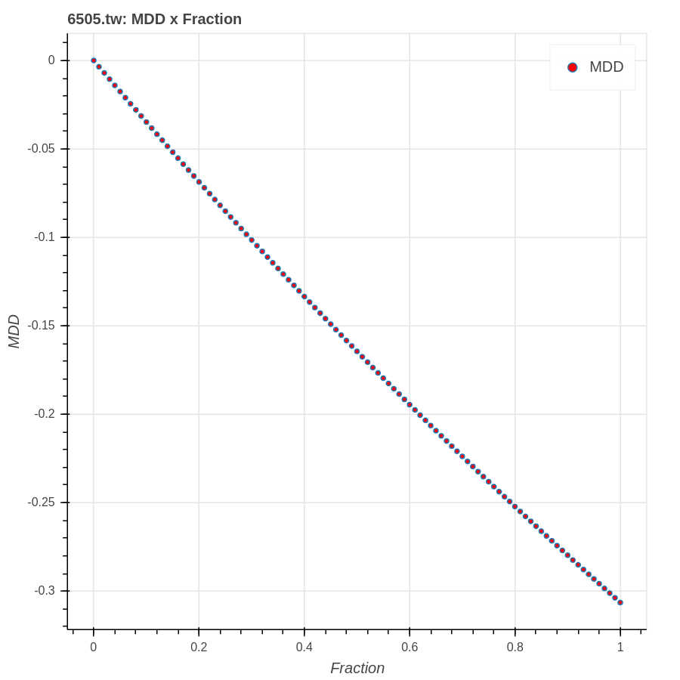
Backtest on 6505.tw:
MDD and Fraction
According to the previous slide, if we want to achieve
Prob(MDD < 10%) > 80%,
our fraction should be about below 21%.
The backtest of real trading data of 6505.tw shows that if we use the fraction below 21%, our MDD can be smaller than 10%.

Slide 34
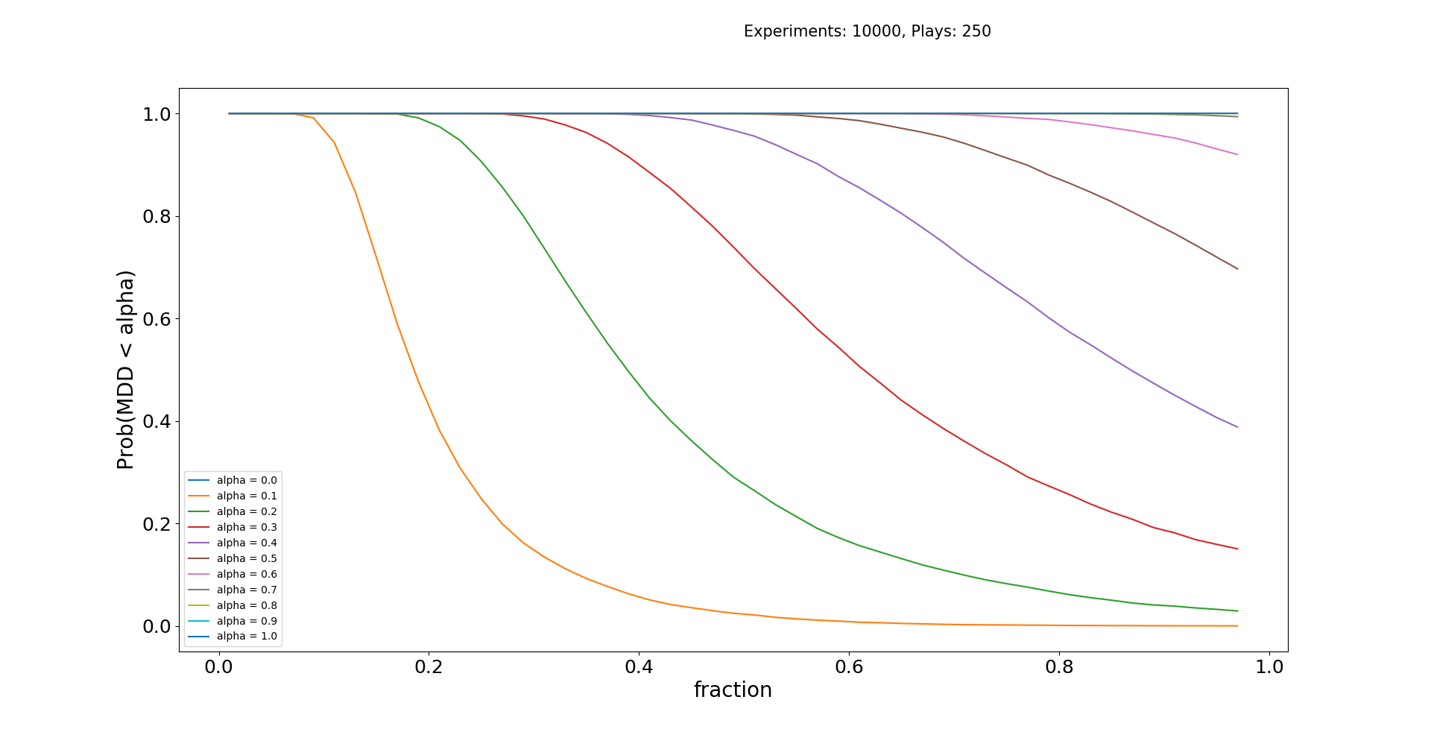
Backtest on 2317.tw (#3 market cap in TW)
Beta > 80% Alpha = 10%

Slide 35
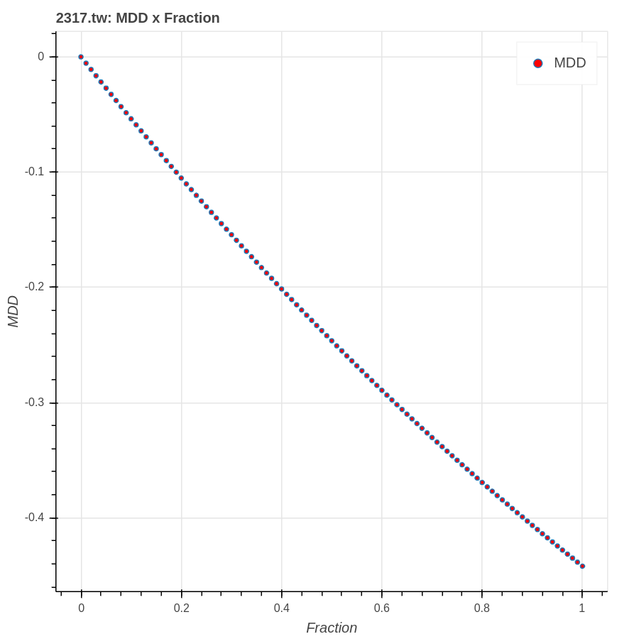
Backtest on 2317.tw:
MDD and Fraction
According to the previous slide, if we want to achieve Prob(MDD < 10%) > 80%, then our fraction should be about below 17.5%.
The backtest of real trading data of 2317.tw shows that if we use the fraction below 17.5%, our MDD can be smaller than 10%.

Slide 36
Leverage Space Model
Paly 1 Game: (1+2f)^{W}(1-f)^{L}
Play 2 Games Simultaneously: (1+2f+2f)^{W1}(1+2f-2f)^{W2}(1-f+2f)^{W3}(1-f-f)^{W4}

Slide 37
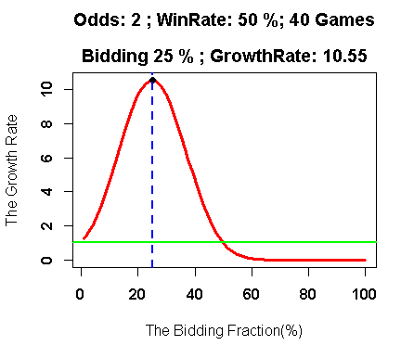
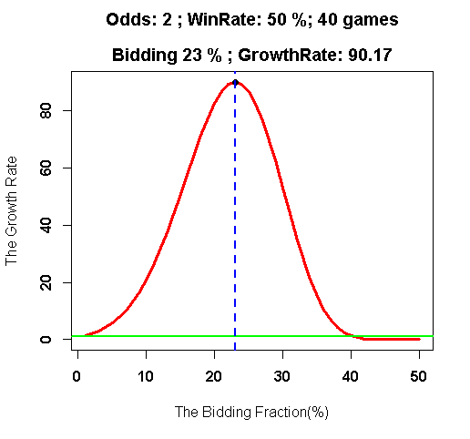
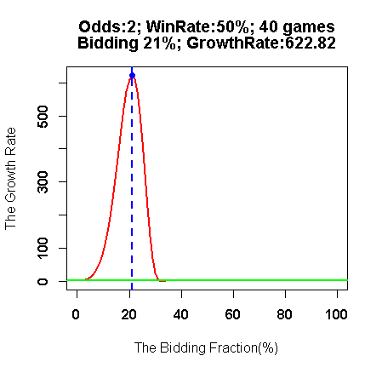
只玩1場40局，
最佳下注比例25%
資金運用達25%!
報酬 1 ➔10
同時玩2場，
每場各壓23%，
資金運用達46%!
10倍 ➔ 90倍
報酬再多9倍!
同時玩3場，
每場各壓21%，
資金運用達63%! 10倍 ➔ 90倍➔622倍
報酬再多62倍!

Slide 38
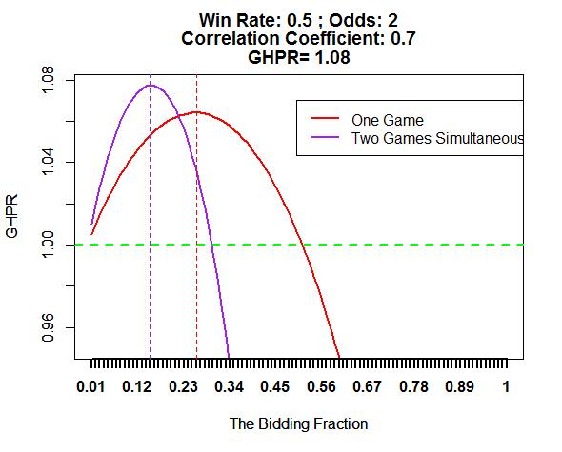
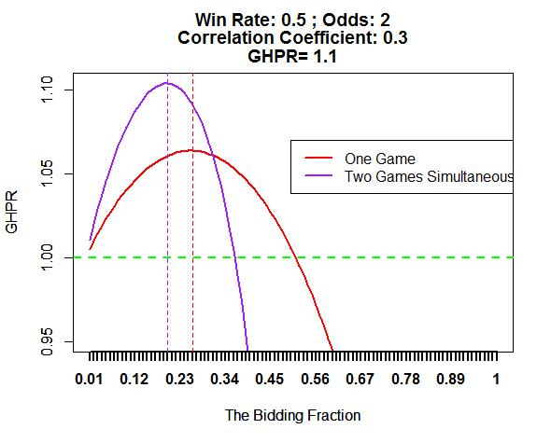
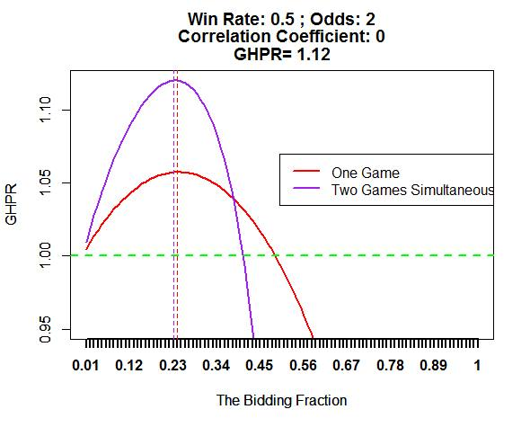
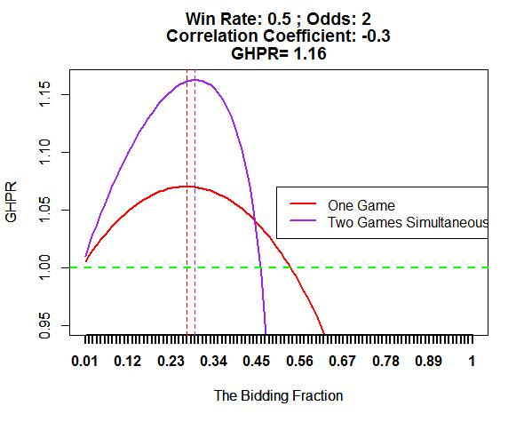
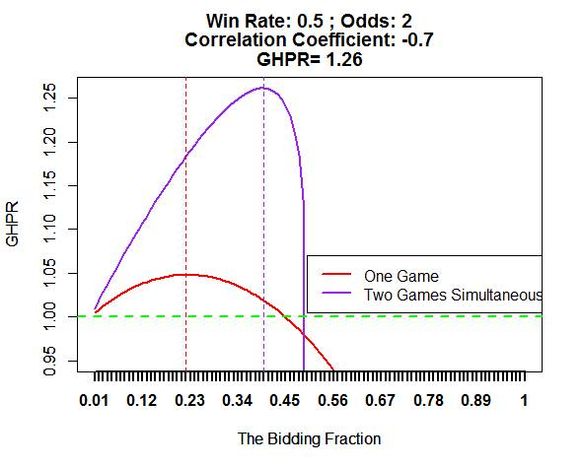
預測相關係數，發揮 “槓桿空間模型”…
0.7
0.3
0
-0.3
-0.7

Slide 39

Conclusion and Future Work
Finding biding fraction such that$Prob. \left(MDD(T)<α\right)<β, where α,β∈(0,1)$
$$MDD\left(T\right)=\max_{τ∈(0, T)}\left[\max_{τ∈(0, T)}{\frac{X\left(t\right)−X(τ)}{X\left(t\right)}}\right]$$
Leverage Space Model for MDD Risk Constraint

Slide 40
Thank You

